Slide 1
IS601-WEB SYSTEMS DEVELOPMENT
FINAL PROJECT
MANIKANTA VARUN THUNGA(mt638)
SAHITHI PENDYALA(sp3322)

Slide 2
FINAL BUSINESS ANALYSIS
1. Competitive Analysis:
Competitor 1: Bella Italia Trattoria - Archetype: Classic and Romantic - Methods of Persuasion: Emphasis on a romantic atmosphere, traditional recipes passed down through generations and personalized service.
Competitor 2: Moderno Cucina - Archetype: Trendy and Innovative - Methods of Persuasion: Fusion of traditional and modern Italian cuisine, stylish decor, and an active social media presence for a contemporary appeal.
Competitor 3: QuickBite Pizzeria - Archetype: Efficient and Affordable - Methods of Persuasion: Quick service, affordable pricing, and online ordering for convenience.
2. SWOT Analysis:- Strengths: Unique 1920s gangster theme, specialized meatball focus, engaging methods of persuasion (reciprocity, social proof, scarcity).- Weaknesses: Potential niche appeal, initial challenge in building awareness.- Opportunities: Growing interest in experiential dining, potential for viral social media marketing, and the flexibility of themed promotions.- Threats: Intense competition in the Italian dining market, fluctuating food costs.

Slide 3
3. One Persona: "Vinny"Demographics: 28 years old, urban professional, enjoys unconventional experiences.Background: Enjoys exploring unique dining concepts, appreciates quality and authenticity, often shares experiences on social media.Behavior: Active on social media platforms, particularly Instagram. Values memorable dining experiences that stand out.Needs: Seeks a dining establishment that offers both entertainment and high-quality food. Appreciates promotions and discounts.
4. Customer Journey/Sales Funnel:- *Awareness:* Utilize organic search optimization and social media (especially Instagram) to increase visibility. Engage users with posts showcasing the gangster theme. - *Interest:* Feature a captivating homepage with gangster-themed imagery and highlight promotions. Introduce the spicy meatball of the month and the buy one get one offer.- *Action:* Prompt users to sign up for a limited-time coupon with a QR code for the spicy meatball promotion. Ensure a seamless online reservation system.- *Loyalty:* Send a follow-up email offering incentives for returning, such as free "bullet breadsticks" and encourage social media sharing for additional benefits.
5. Initial Set of User Stories:Initiative: Captivating Online Presence - Epic (Awareness): As a potential customer, I want "Fat Tony's Hideout" to stand out when searching online for unique dining experiences.Initiative: Entertaining Homepage - Epic (Interest): As a user exploring the website, I want to be captivated by gangster-themed imagery that conveys the restaurant's atmosphere and promotions.Initiative: Seamless Interaction - Epic (Action): As a customer, I want a straightforward process to sign up for a coupon and make a reservation online.

Slide 4
DESIGN & TECHNOLOGY RESEARCH
Business Description: "Piazza Gustoso" is an Italian restaurant that transports diners to the heart of Italy through its authentic cuisine and inviting ambiance. Embracing a rustic yet contemporary theme, the restaurant offers a diverse menu featuring traditional Italian dishes made with fresh, locally sourced ingredients. With a commitment to excellence and a warm atmosphere, Piazza Gustoso aims to provide a memorable dining experience for patrons seeking the true taste of Italy.
Result of SWOT Analysis:Strengths: Authentic and diverse menu, locally sourced ingredients, inviting ambiance.Weaknesses: Potential competition from other Italian restaurants, initial marketing challenges.Opportunities: Growing interest in authentic international cuisine, the potential for catering services.Threats: Intense competition in the Italian dining market, fluctuating food costs.
Competitive Landscape: In a bustling Italian dining landscape, Piazza Gustoso distinguishes itself through a blend of authenticity and modernity. The restaurant stands out with its commitment to using fresh, locally sourced ingredients, providing a genuine Italian dining experience. Emphasizing warm hospitality and a diverse menu, Piazza Gustoso competes effectively with traditional and contemporary Italian establishments, appealing to a broad range of customers seeking an authentic taste of Italy in a welcoming setting.

Slide 5
Persona:
Name: IsabellaDemographics: 30 years old, professional, resides in an urban areaBackground: Isabella has a busy work life, often seeking a culinary escape to unwind. She appreciates quality dining experiences and has a discerning taste for authentic international cuisine.Interests: Enjoys exploring different cultures through food, appreciates local and organic ingredients, values ambiance and a comfortable setting.Behavior: Isabella is an active social media user, frequently sharing her dining experiences. She relies on online reviews and recommendations when choosing restaurants. She appreciates personalized service and is willing to pay for a memorable dining experience.Needs: Seeks a genuine Italian dining experience that goes beyond mainstream offerings. Values a warm and inviting atmosphere, where she can savor authentic flavors and enjoy a leisurely meal. Isabella is open to trying new dishes and appreciates a menu that caters to various dietary preferences.Goals: To find an Italian restaurant that not only satisfies her taste buds with authentic dishes but also provides a welcoming ambiance where she can relax and enjoy quality time with friends or family.Pain Points: Frustrated with generic Italian restaurants that compromise on authenticity. Disappointed when menus lack variety and creativity. Values efficient service and dislikes long wait times.This persona, Isabella, represents the target customer for Piazza Gustoso, seeking a genuine and memorable Italian dining experience with a focus on quality, ambiance, and authenticity.

Slide 6
Sales Funnel:
Awareness:Channels: Utilize online platforms, social media, and local event sponsorships.Content: Engaging posts showcasing authentic Italian dishes, behind-the-scenes glimpses, and customer testimonials.Goal: Increase brand visibility and attract potential customers like Isabella.Interest: Hero Content: Feature a captivating video tour of Piazza Gustoso, highlighting the rustic-contemporary ambiance and chefs in action.Promotions: Introduce limited-time offers or special menu items to create excitement.Goal: Capture Isabella's interest and prompt her to explore the menu.Action: Website Interaction: Ensure a user-friendly website with a visually appealing menu and easy online reservation functionality.CTA (Call-to-Action): Prominently display a "Book Now" button on the website and social media platforms.Promotional Incentive: Offer a small discount or complimentary appetizer for online reservations.Goal: Encourage Isabella to make a reservation and experience Piazza Gustoso's authentic Italian cuisine.Purchase: Dining Experience: Provide attentive service, ensuring a seamless and enjoyable dining experience.Upselling: Train staff to suggest wine pairings or dessert options to enhance Isabella's overall satisfaction.Feedback: Encourage feedback through post-meal surveys or social media reviews.Goal: Ensure Isabella is delighted with the dining experience, increasing the likelihood of her return.Loyalty: Follow-Up Email: Send a personalized thank-you email to Isabella, expressing gratitude for her visit.Exclusive Offers: Include exclusive loyalty offers in follow-up emails, such as discounts on future visits or a loyalty program.Social Media Engagement: Encourage Isabella to follow Piazza Gustoso on social media for updates and exclusive promotions.Goal: Foster a long-term relationship with Isabella, turning her into a loyal and repeat customer. This sales funnel for Piazza Gustoso is designed to guide potential customers, like Isabella, from initial awareness to becoming loyal patrons, emphasizing an immersive and authentic Italian dining experience.

Slide 7
Top Level User Stories:
Initiative: Discovering Authentic Italian DiningEpic (Awareness): As a potential customer, I want to discover our Italian restaurant when searching for authentic Italian dining options online.
Initiative: Captivating Online PresenceEpic (Interest): As a user exploring our website and social media, I want to be captivated by engaging content that showcases the restaurant's ambiance and unique offerings.
Initiative: Seamless Reservation ProcessEpic (Action): As a potential customer, I want to easily navigate our website and make a reservation online to ensure a hassle-free dining experience.
Initiative: Exceptional Dining ExperienceEpic (Purchase): As a diner at our restaurant, I want to experience attentive service and have the option for staff recommendations to enhance my overall dining experience.
Initiative: Building a Long-Term RelationshipEpic (Loyalty): As a customer, I want to receive a personalized follow-up email after dining, expressing gratitude and offering exclusive loyalty incentives for future visits.

Slide 8
Task Level User Stories
Epic (Awareness): Discovering Authentic Italian DiningTask (User Story): As a potential customer, I want Piazza Gustoso to appear within the top three results when searching for "authentic Italian dining" online.Acceptance Criteria: Implement SEO strategies to optimize the website for relevant keywords. Ensure accurate and up-to-date business information on online directories. Monitor and respond to customer reviews on platforms like Google and Yelp. Epic (Interest): Captivating Online PresenceTask (User Story): As a user exploring Piazza Gustoso's website, I want to be captivated by a video tour showcasing the restaurant's ambiance and authentic Italian offerings. Acceptance Criteria: Produce a high-quality video that highlights the rustic-contemporary decor, chefs in action, and satisfied customers. Embed the video prominently on the homepage of the website. Include engaging captions and visuals that evoke the essence of authentic Italian dining. Task (User Story): As a user on social media, I want to encounter engaging posts and promotions that entice me to explore Piazza Gustoso further.Acceptance Criteria: Regularly post visually appealing images of signature dishes, emphasizing quality and authenticity. Share limited-time promotions or special menu items to create a sense of urgency. Respond promptly to comments and engage with the online community. Epic (Action): Seamless Reservation ProcessTask (User Story): As a potential customer, I want to easily navigate Piazza Gustoso's website and make a reservation online.Acceptance Criteria: Ensure a clear and intuitive website layout with a visible "Book Now" button. Implement a user-friendly reservation system that allows for date, time, and party size selection. Provide confirmation emails with reservation details and any relevant promotions. Epic (Purchase): Exceptional Dining ExperienceTask (User Story): As a diner at Piazza Gustoso, I want to experience attentive service and have the option for staff recommendations.

Slide 9
Acceptance Criteria: Train staff to provide excellent customer service, including attentive table service and prompt responses to inquiries. Encourage staff to suggest wine pairings or dessert options to enhance the overall dining experience. Monitor and address any issues promptly to ensure customer satisfaction. Epic (Loyalty): Building a Long-Term RelationshipTask (User Story): As a customer, I want to receive a personalized thank-you email after dining at Piazza Gustoso, with exclusive loyalty offers. Acceptance Criteria: Send a personalized thank-you email within 24 hours of the dining experience, expressing gratitude and inviting feedback. Include exclusive loyalty offers in the email, such as discounts on future visits or participation in a loyalty program. Encourage customers to follow Piazza Gustoso on social media for ongoing updates and exclusive promotions.

Slide 10
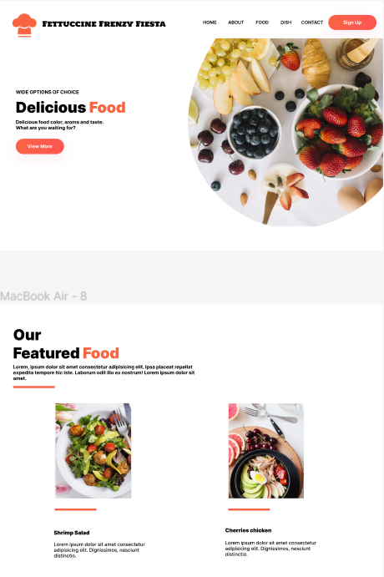
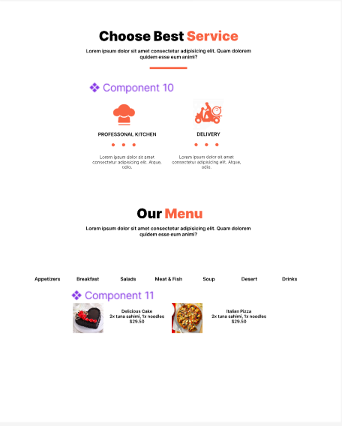
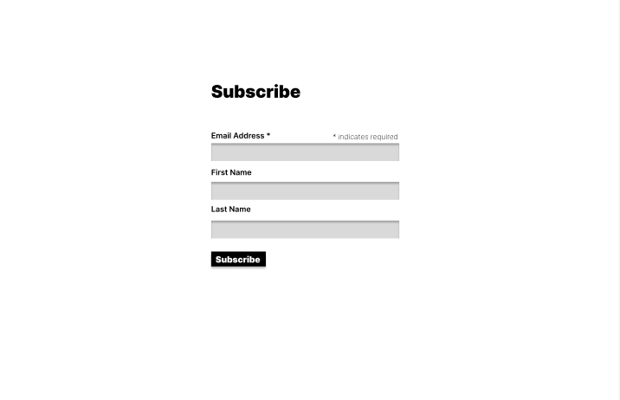
FIGMA DESIGN A MODEL

Slide 11
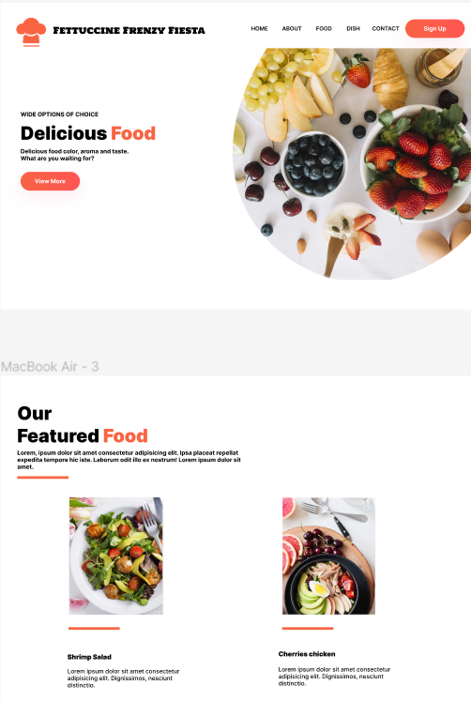
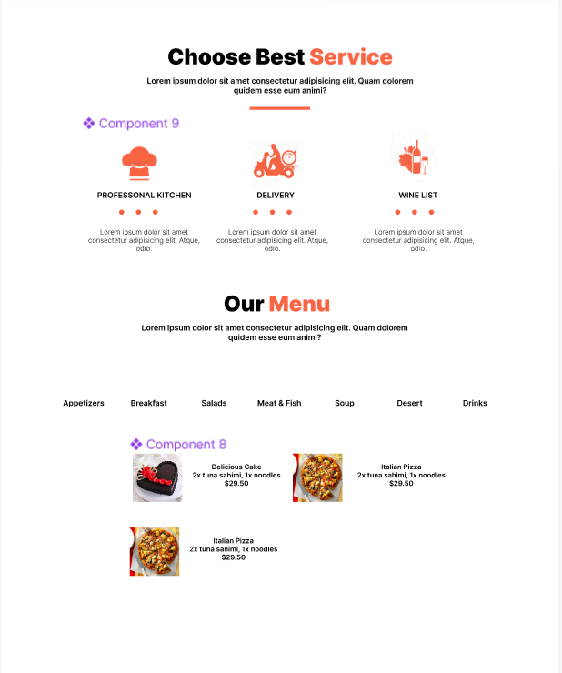
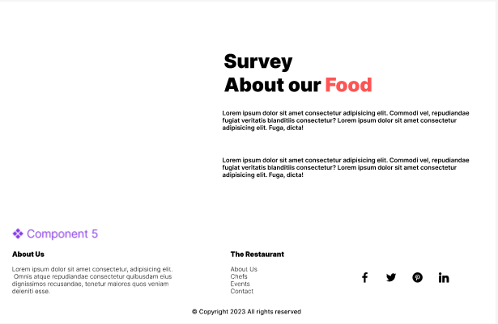
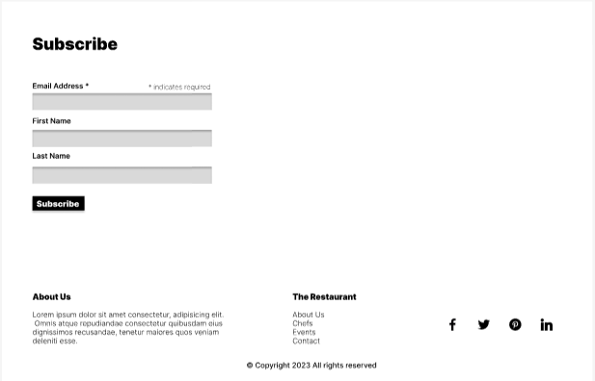
FIGMA DESIGN B MODEL

Slide 12
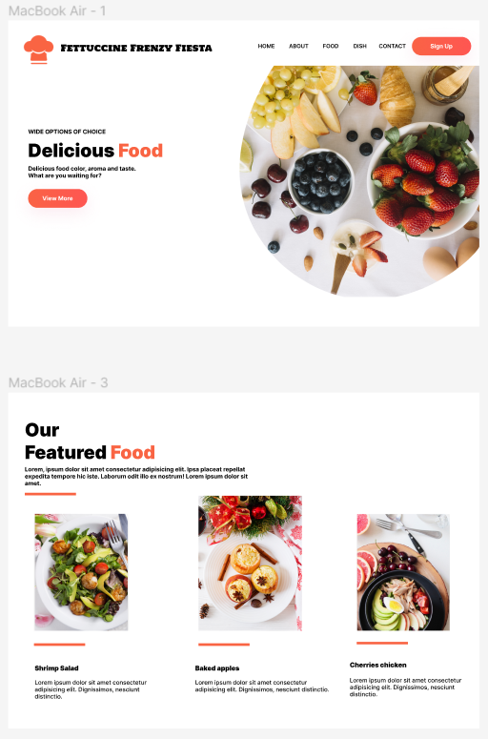
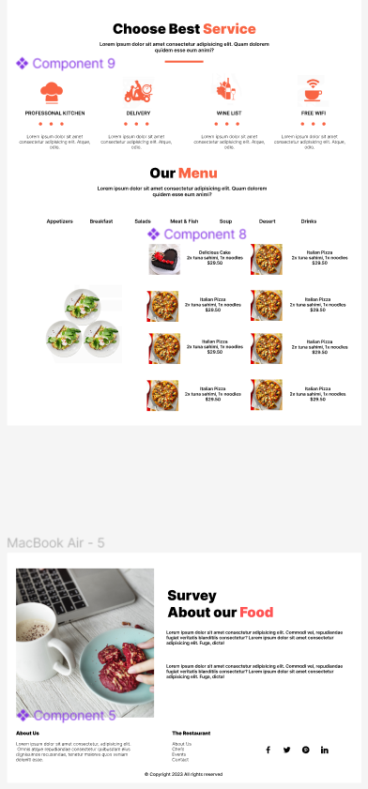
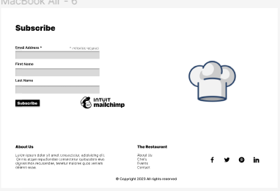
FINAL FIGMA DESIGN

Slide 13
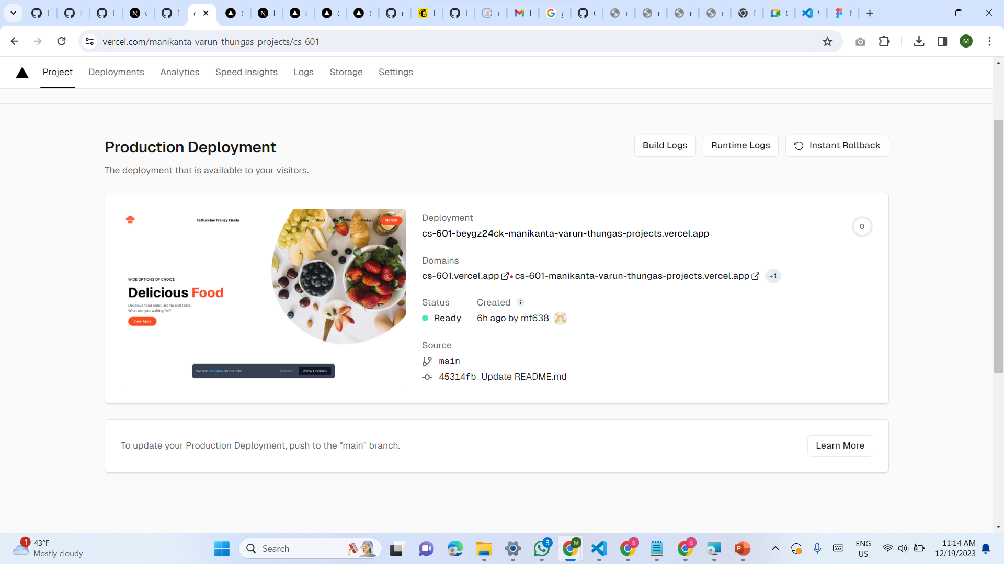
VERCEL DEPLOYMENT

Slide 14
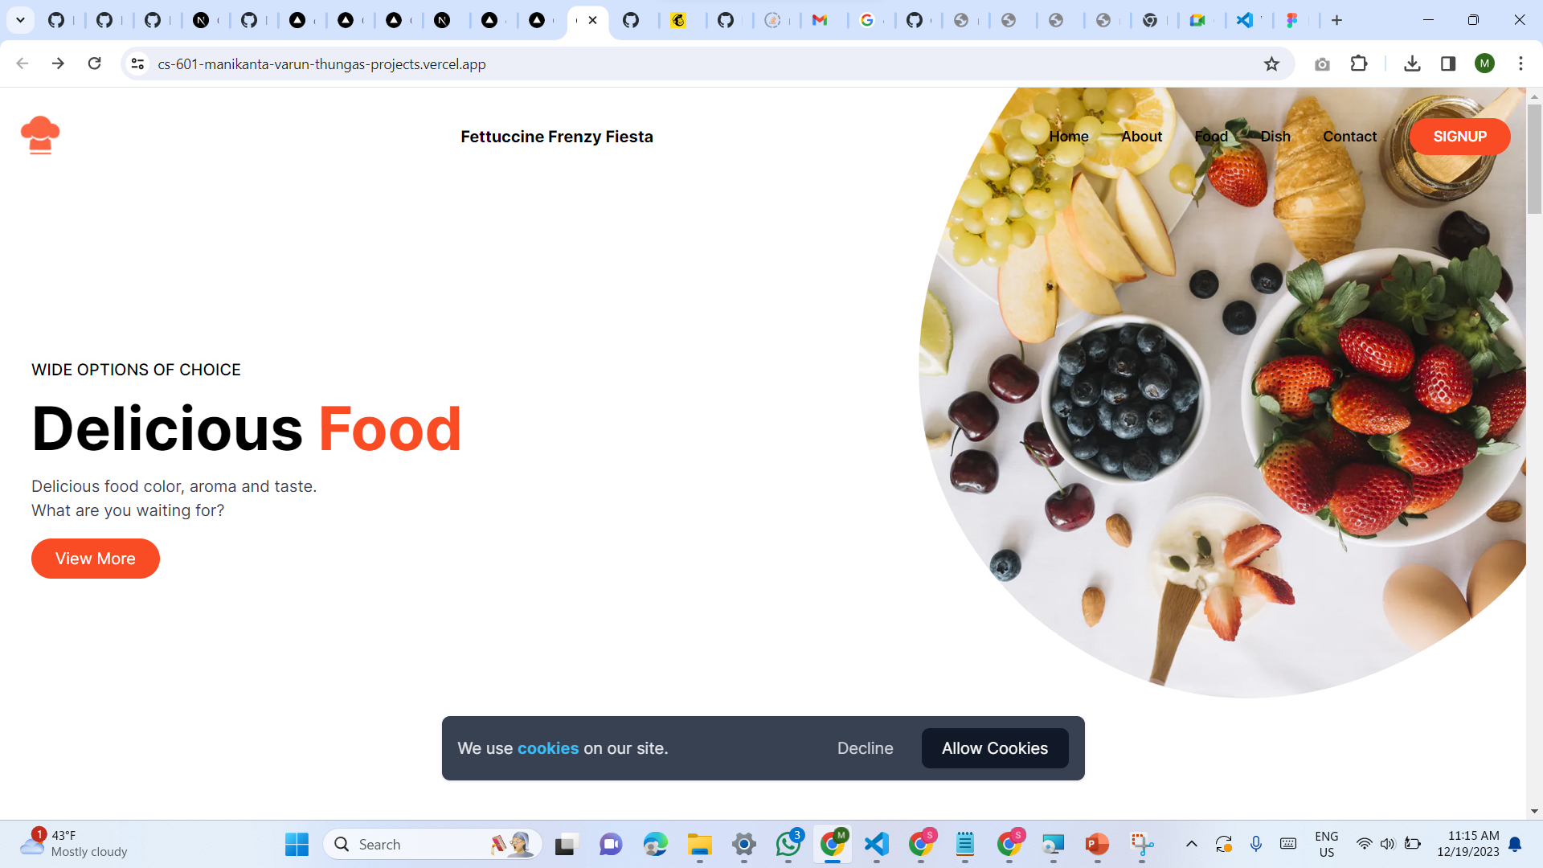
LANDING PAGE

Slide 15
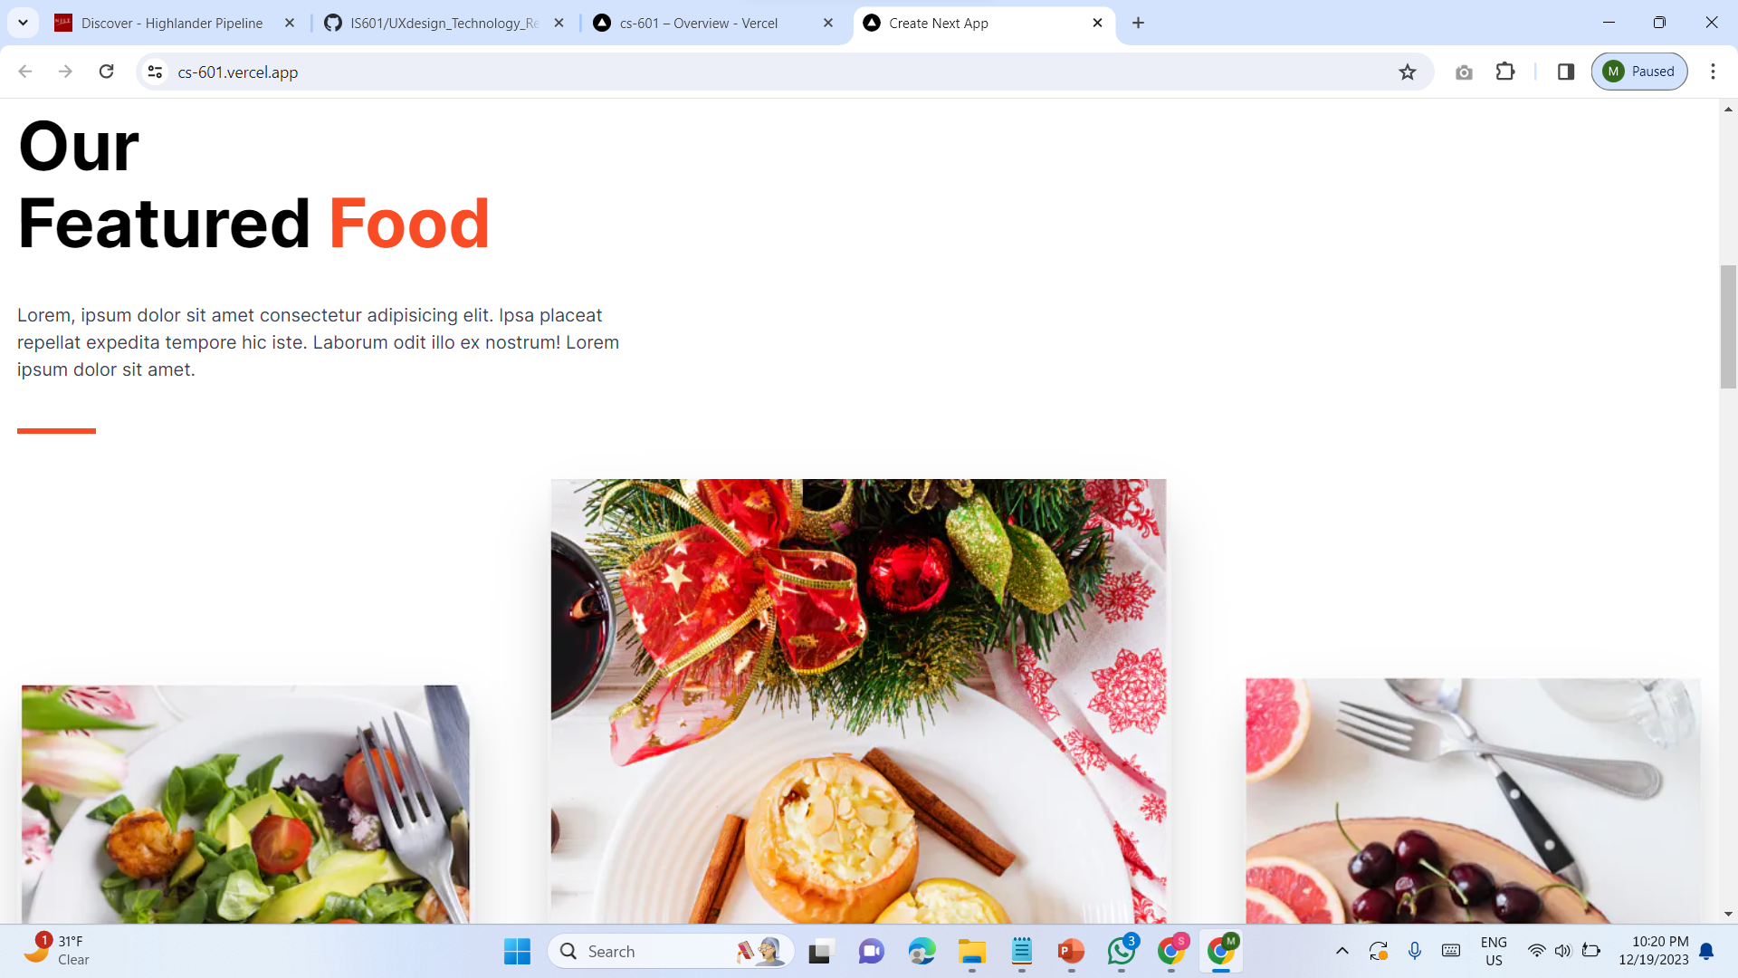

Slide 16
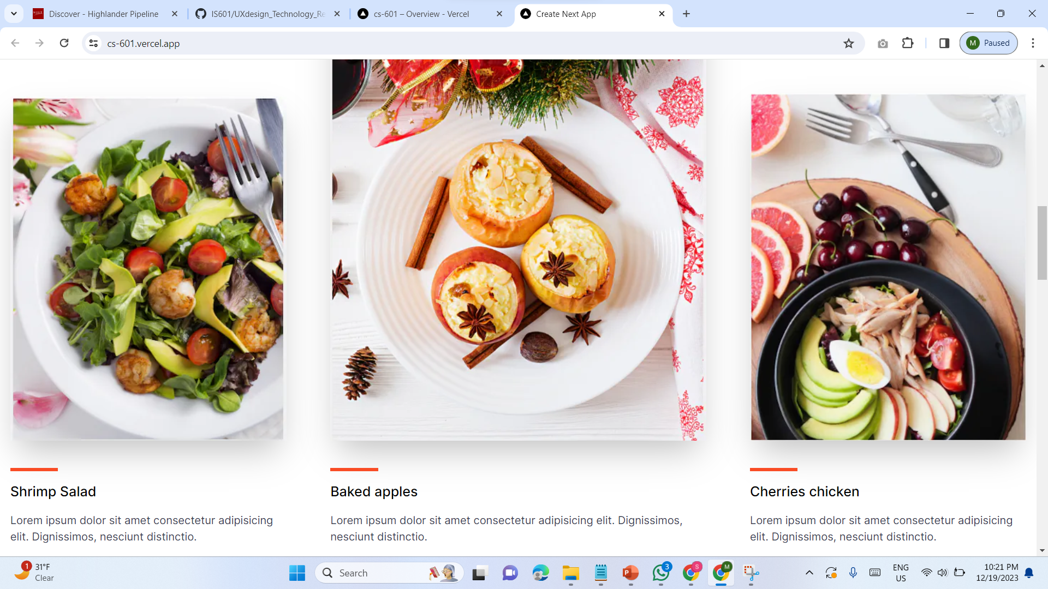

Slide 17
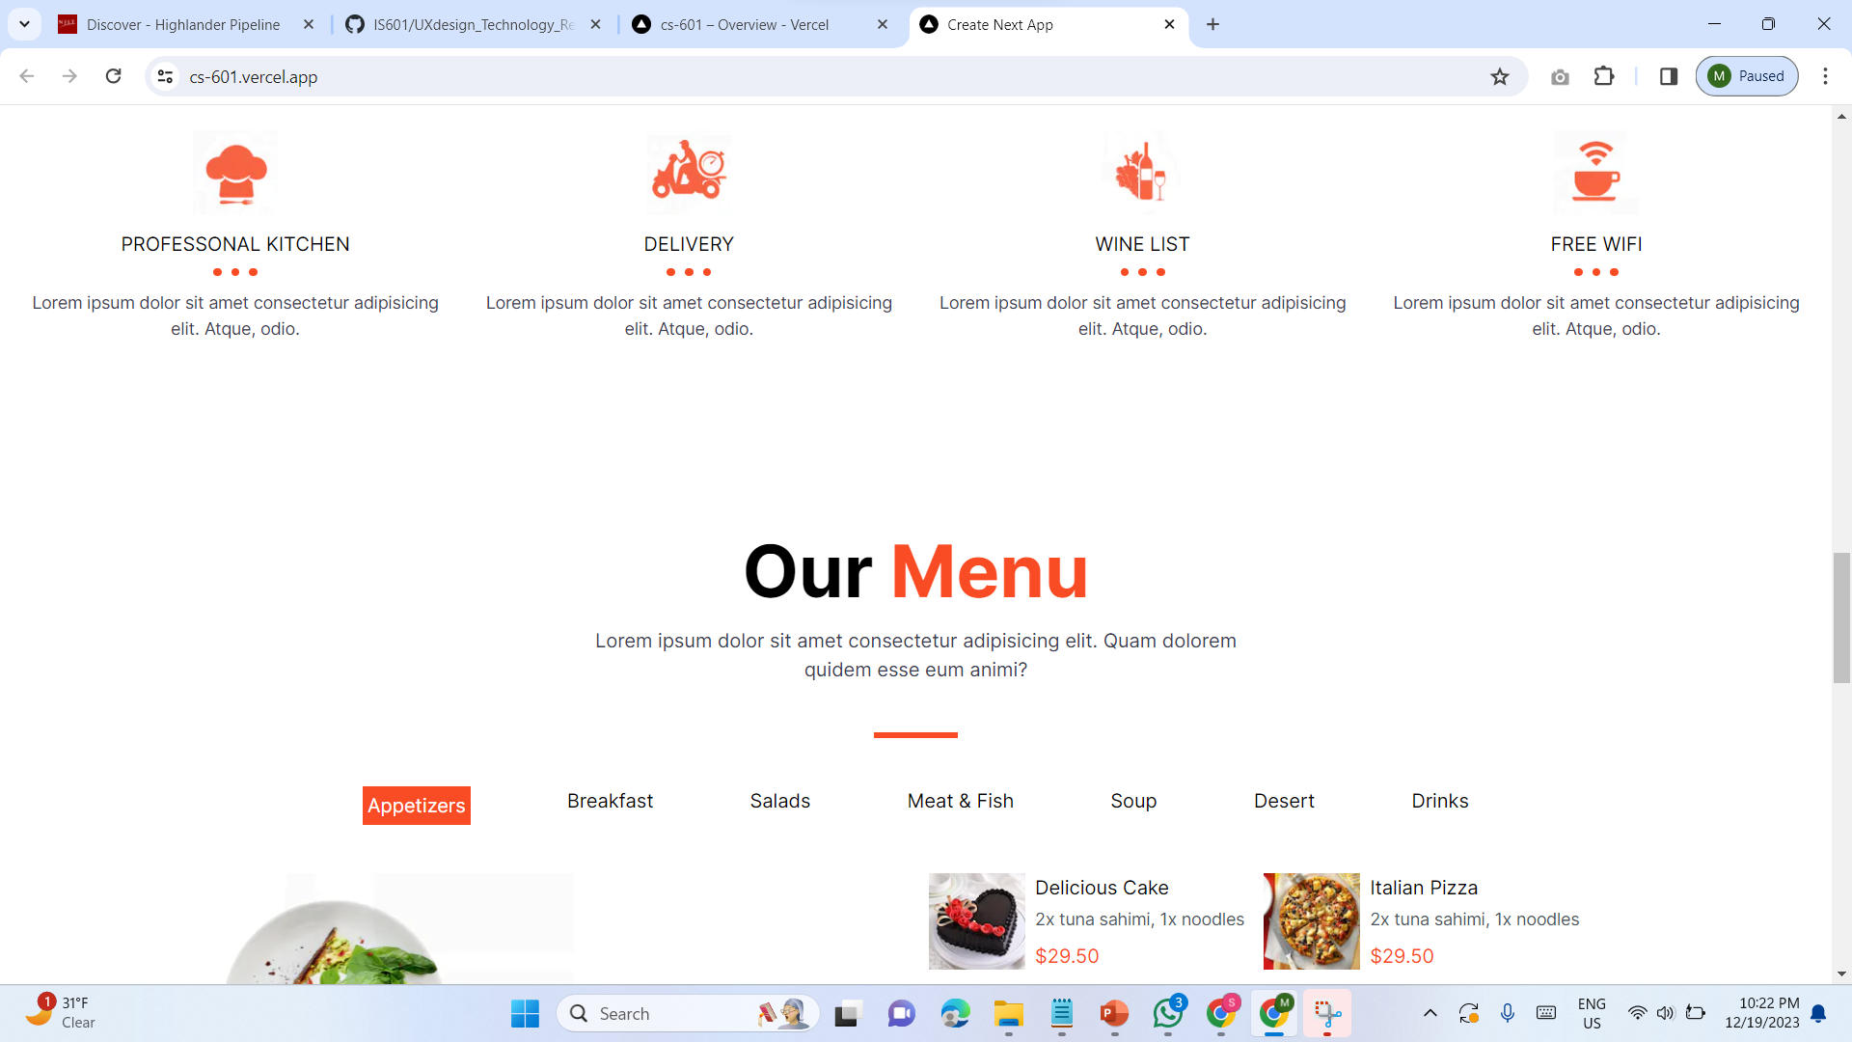

Slide 18
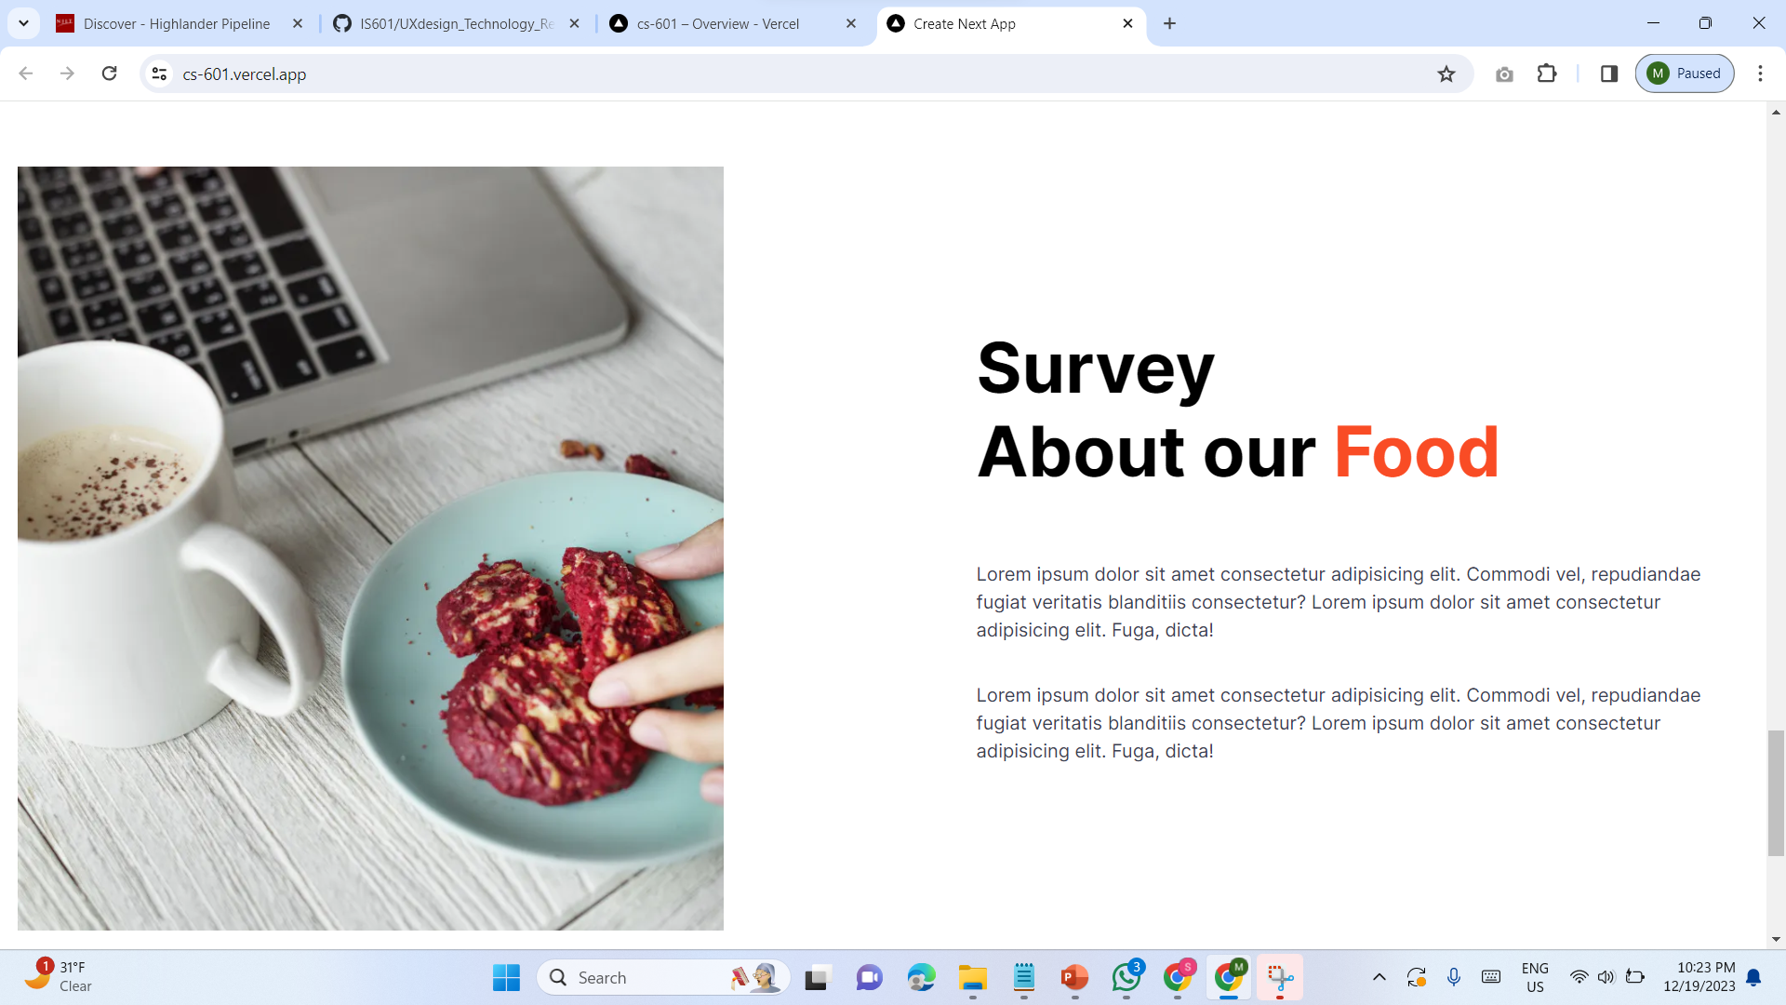

Slide 19
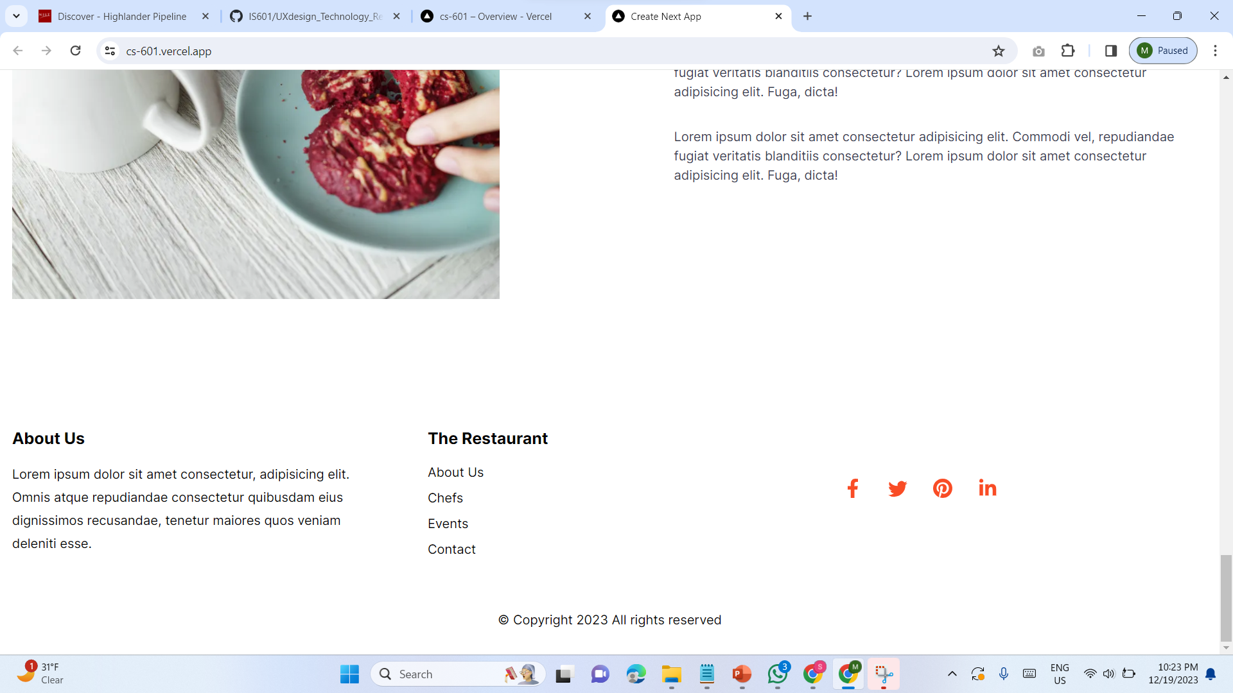

Slide 20
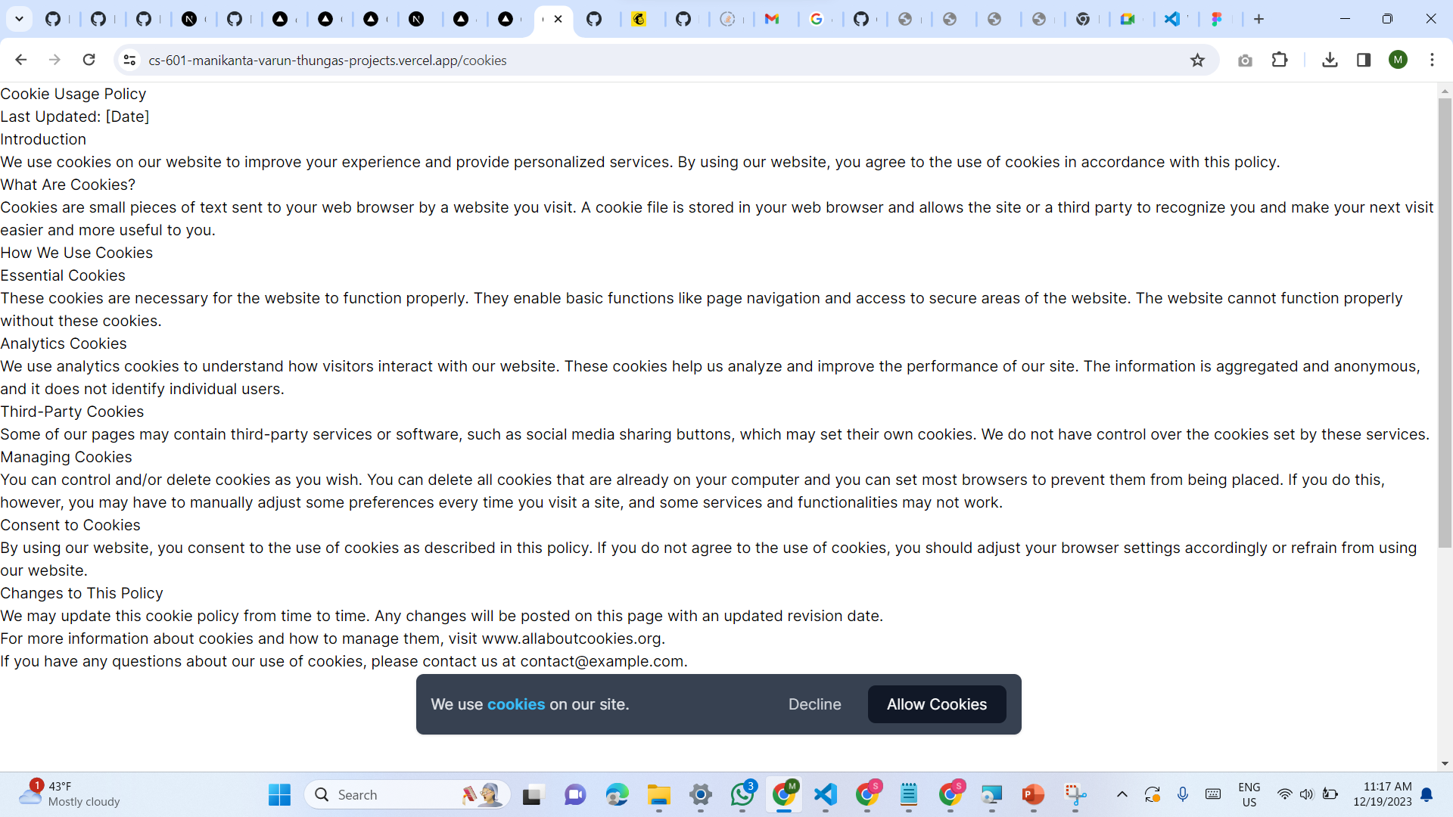
COOKIE USAGE POLICY

Slide 21
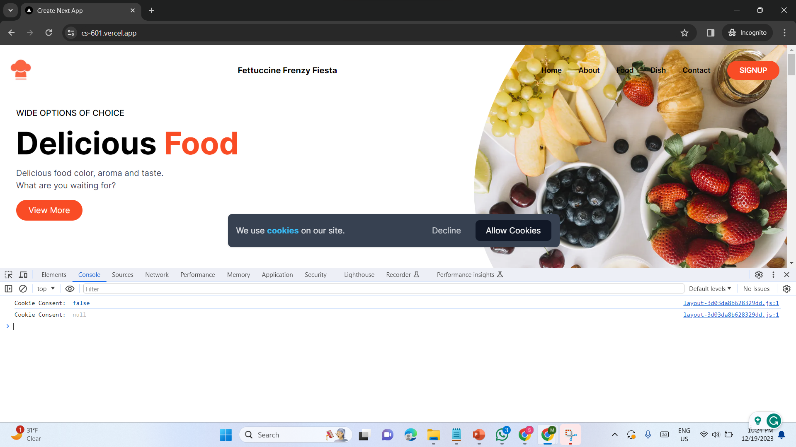

Slide 22
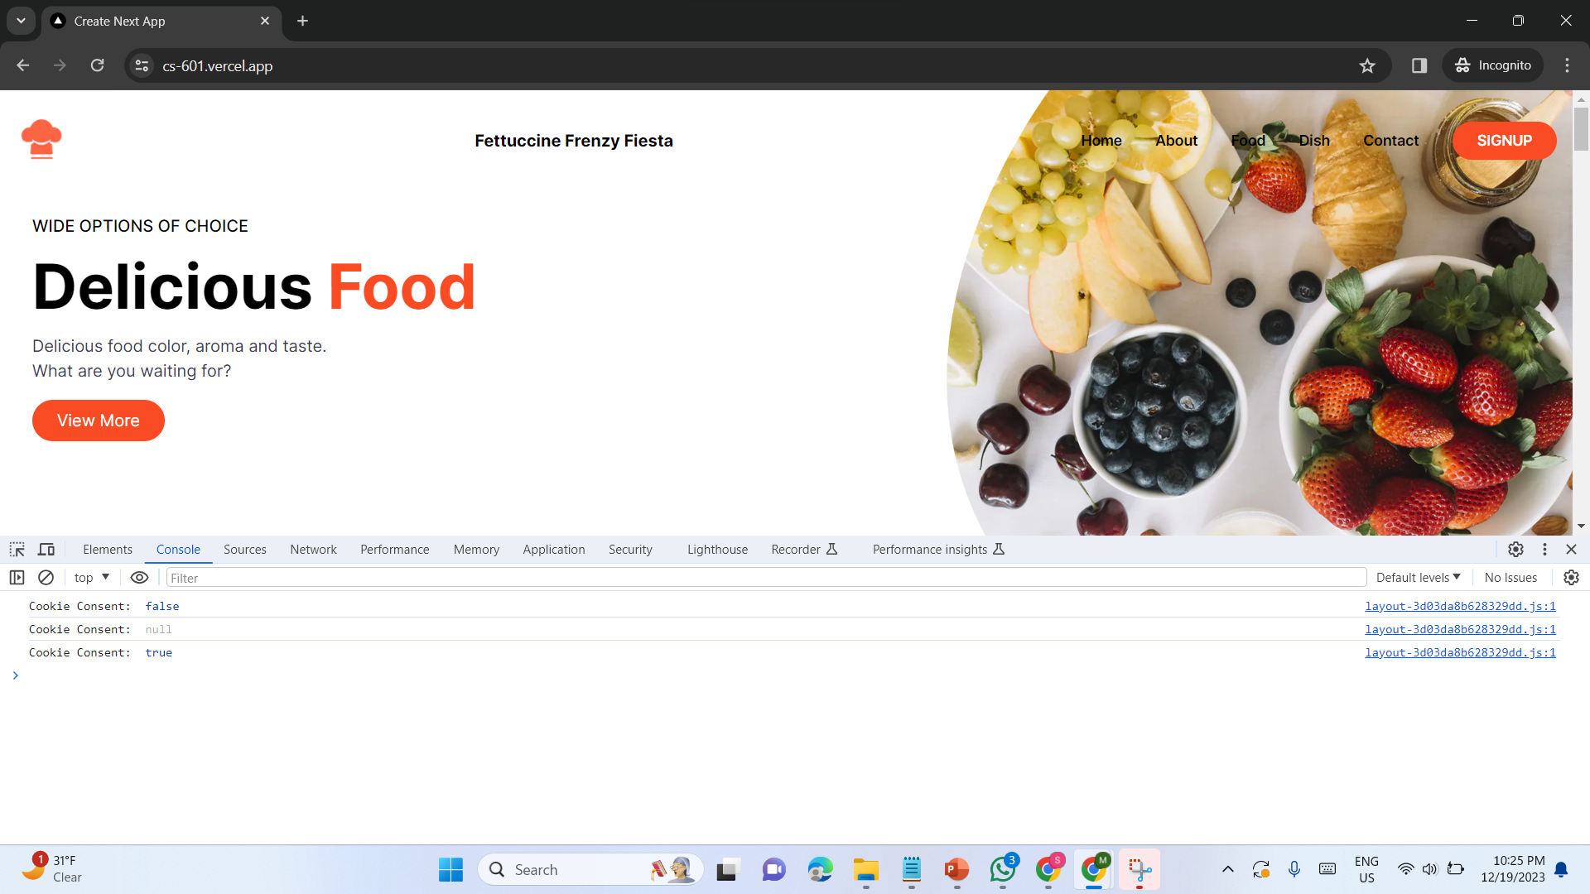

Slide 23
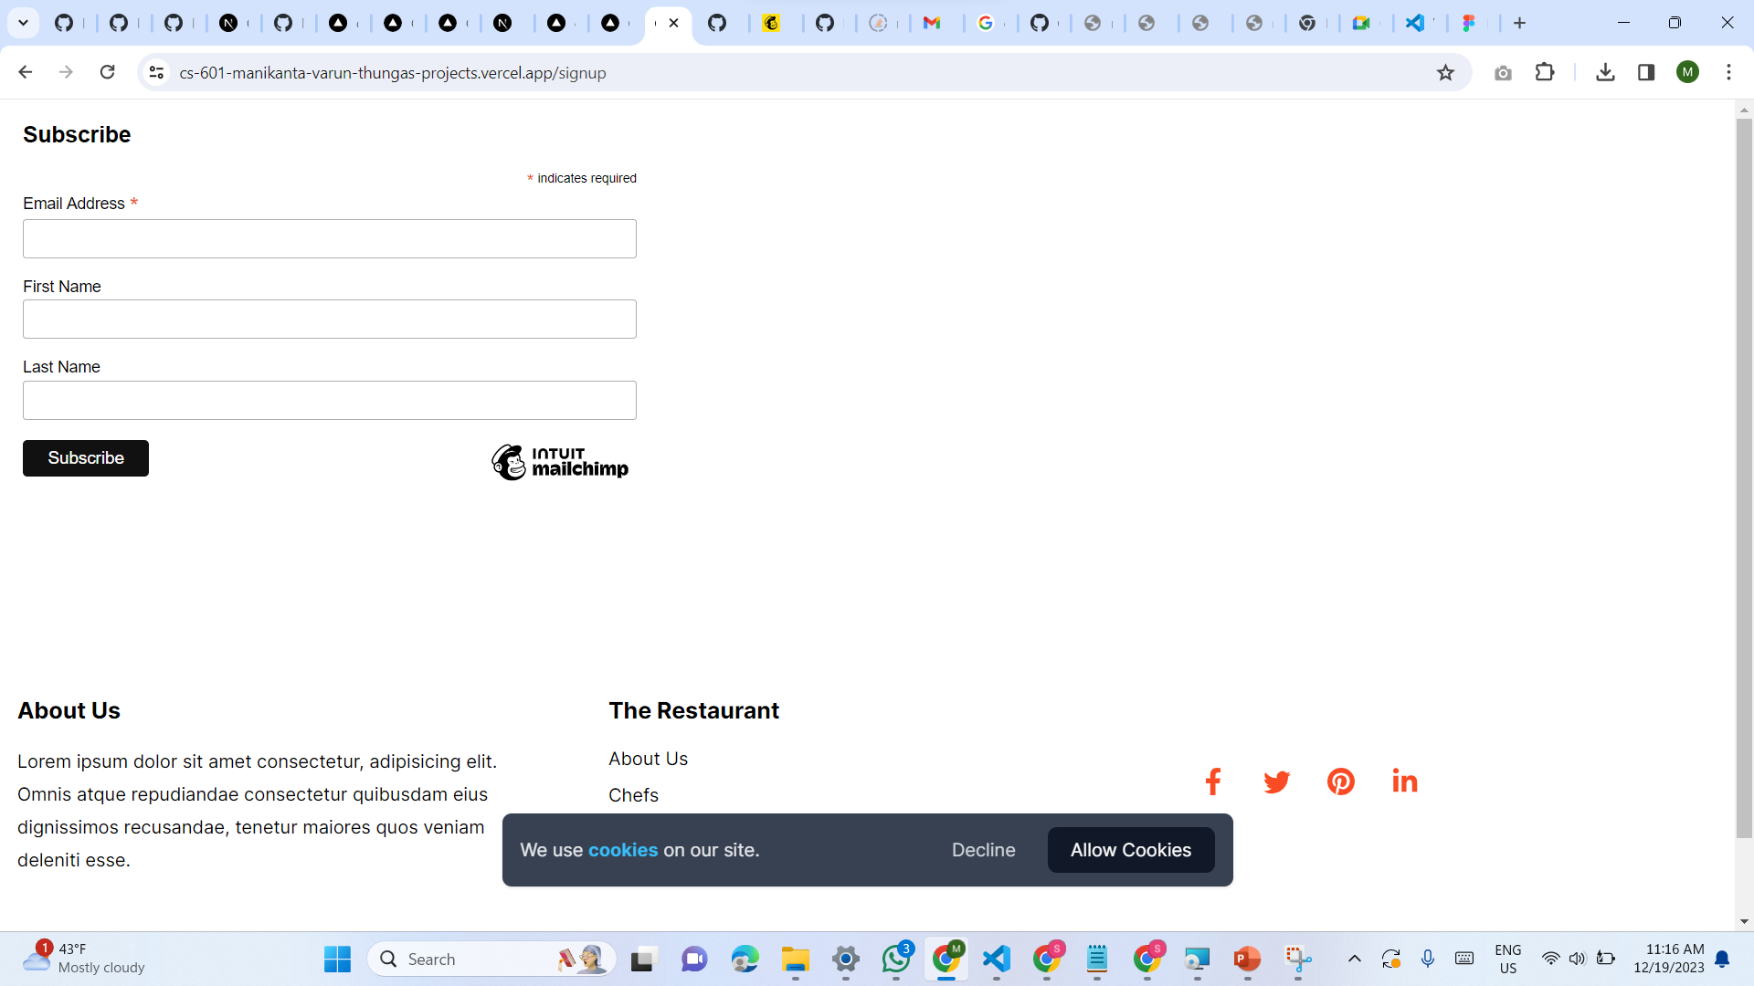
MAILCHIMP

Slide 24
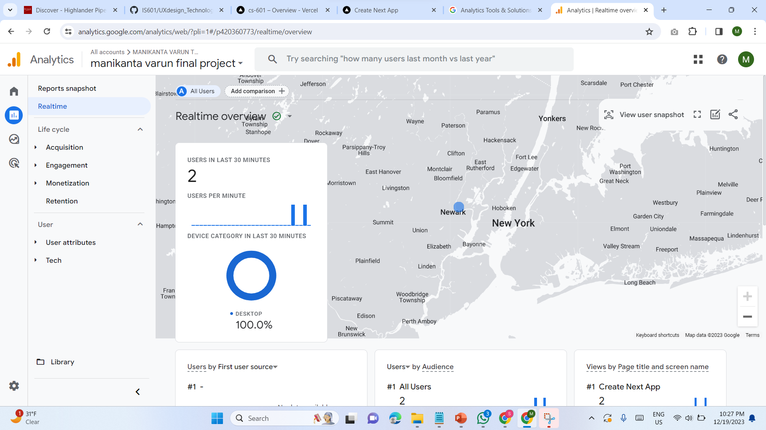
GOOGLE ANALYTICS

Slide 25
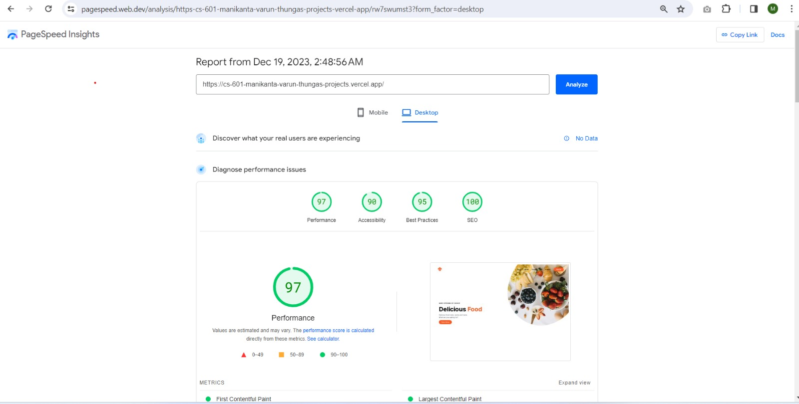
LIGHTHOUSE

Slide 26
THANK YOU…

